Slide 1
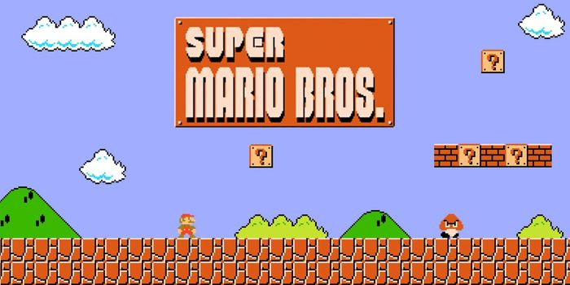
Super Platformer
Aurélien VISENTIN
Cloé ESCUDIER
Heiko CARLIER
Corentin PION

Slide 2
Summary
Origins
Tools used
Tasks distribution
Game development
Encountered problems and solutions
Game demo
The outcome

Slide 3



Origins
Platforms game
2D
For any public

Slide 4
Tools used
Tasks | Aurélien | Cloé |  | Corentin | Heiko
Commands | S | R
Game mechanics | S | R
Animations |  |  |  | R | S
Scenario |  | R |  | S
Artificial intelligences | R | S
Graphisms |  |  |  | R | S
Sound design |  | S |  |  | R
User interfaces and overlays |  |  |  | S | R
Website | R |  |  |  | S
Installation | R |  |  | S
R : Responsible |  |  | S : Suppliant

Slide 5
Task distribution
Tasks | Aurélien | Cloé |  | Corentin | Heiko
Commands | S | R
Game mechanics | S | R
Animations |  |  |  | R | S
Scenario |  | R |  | S
Artificial intelligences | R | S
Graphisms |  |  |  | R | S
Sound design |  | S |  |  | R
User interfaces and overlays |  |  |  | S | R
Website | R |  |  |  | S
Installation | R |  |  | S
R : Responsible |  |  | S : Suppliant
Jump
Crouch
Move left and right
Attack

Slide 6
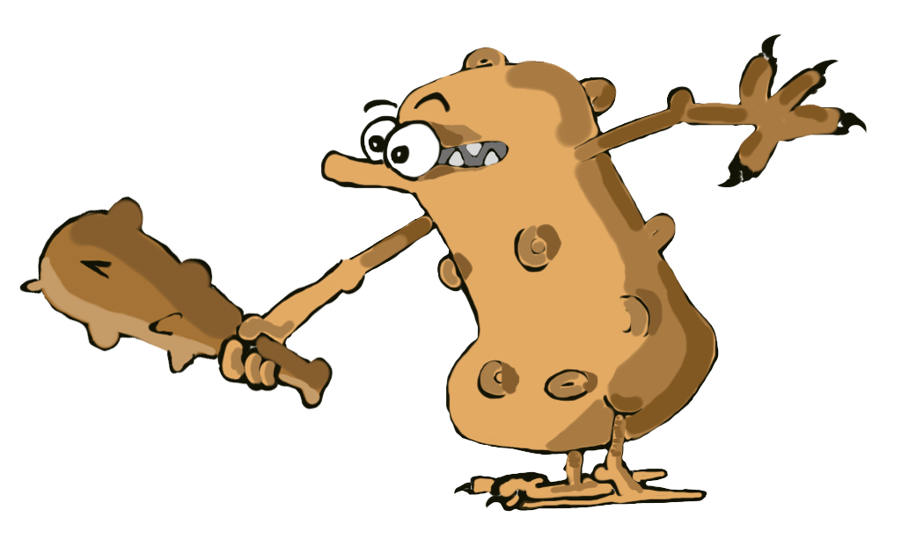
Game development: Game mechanics
Tasks | Aurélien | Cloé |  | Corentin | Heiko
Commands | S | R
Game mechanics | S | R
Animations |  |  |  | R | S
Scenario |  | R |  | S
Artificial intelligences | R | S
Graphisms |  |  |  | R | S
Sound design |  | S |  |  | R
User interfaces and overlays |  |  |  | S | R
Website | R |  |  |  | S
Installation | R |  |  | S
R : Responsible |  |  | S : Suppliant
Jump
Crouch
Move left and right
Attack

Slide 7
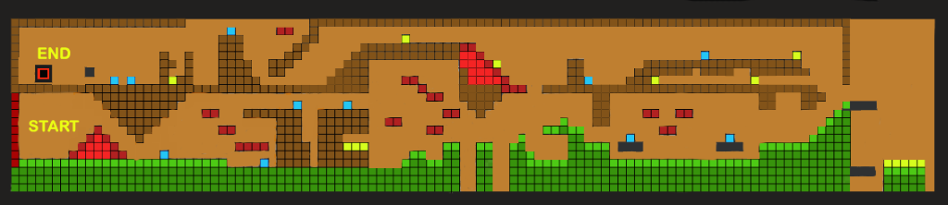
Game development: Artificial intelligences
Three types of AI
Follower
“Back and forth”
Fireball
Notes:
Two first monster

Slide 8
Game development: Scenario
Goal Save the world
Triforce Artefact

Slide 9
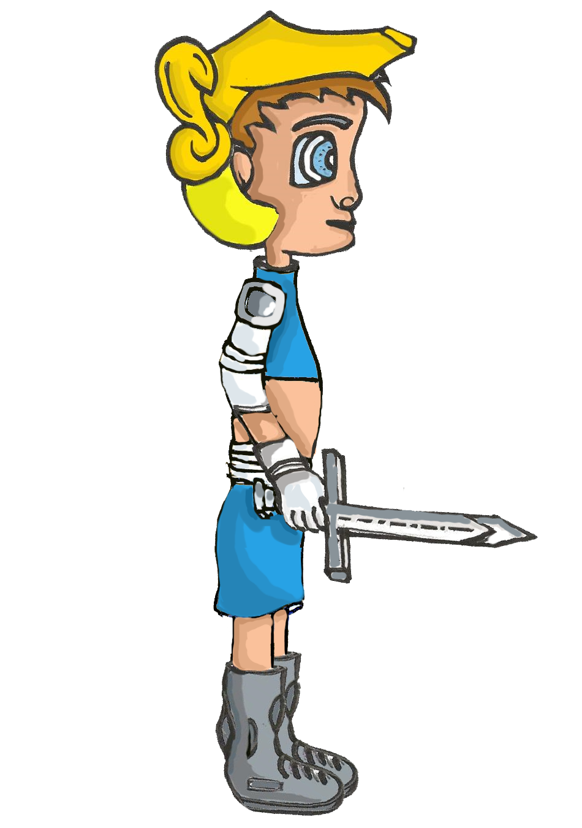
Game development: Levels
3 levels
For example : Space level
3 different times
Different characteristics
Low gravity
Hero
Nemesis

Slide 10
Game development: Graphics
Hero
Nemesis
Potion
Triforce

Slide 11

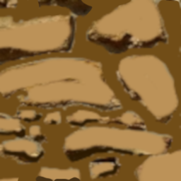

Game development: Graphics
Potion
Triforce

Slide 12
Game development: Graphics
Blocs :

Slide 13
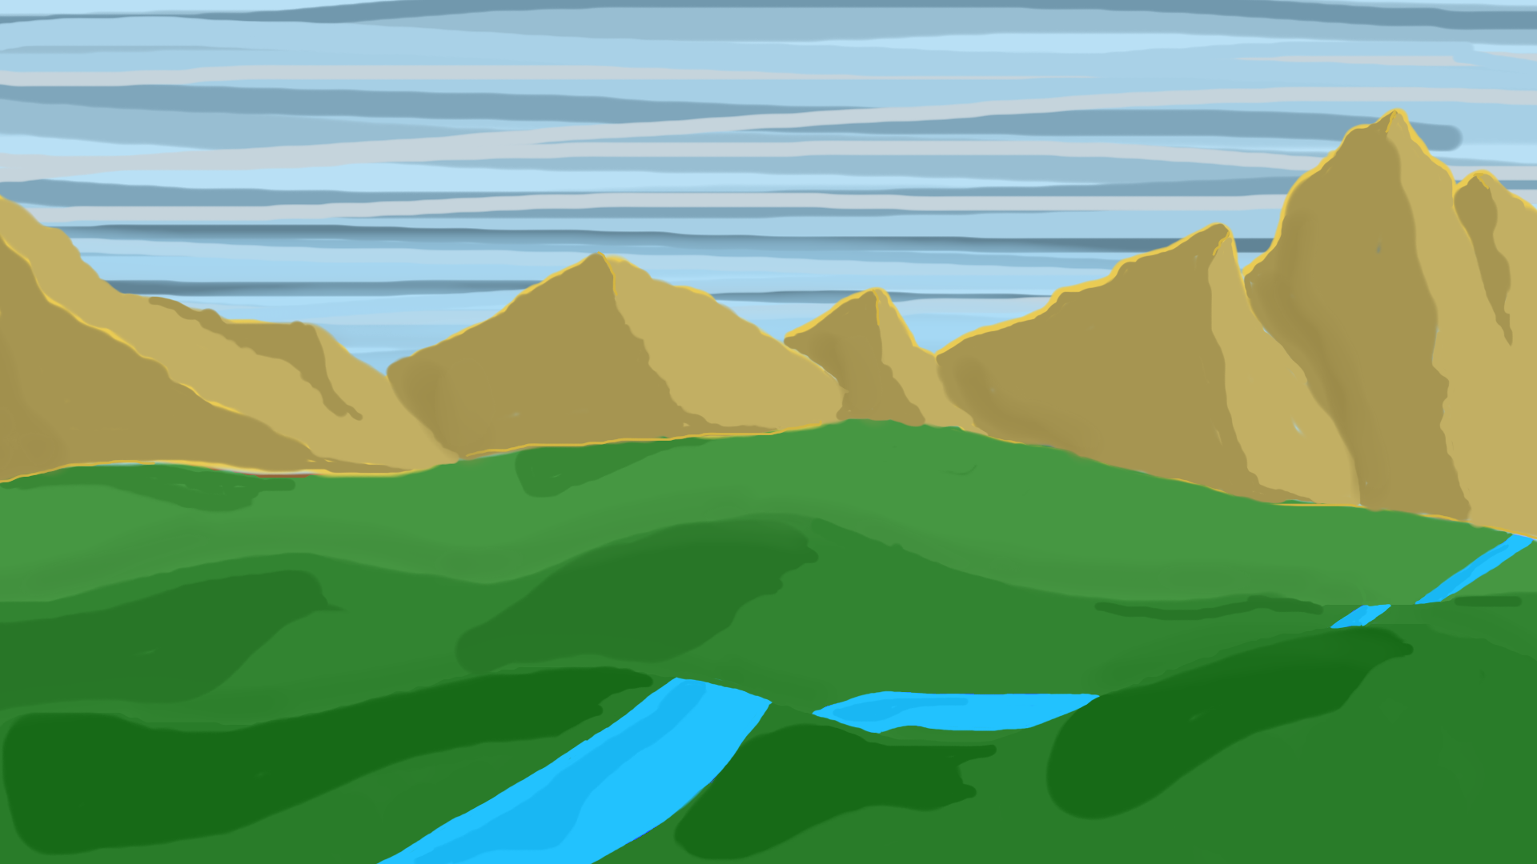

Background used for the present

Slide 14

Game development: Animations
First part of the images of the coin animation

Slide 15

Game development: Sound design
Approaching Nirvana
Derek & Brandon Fiechter
Lullaby of Creation
Sekhmet

Slide 16
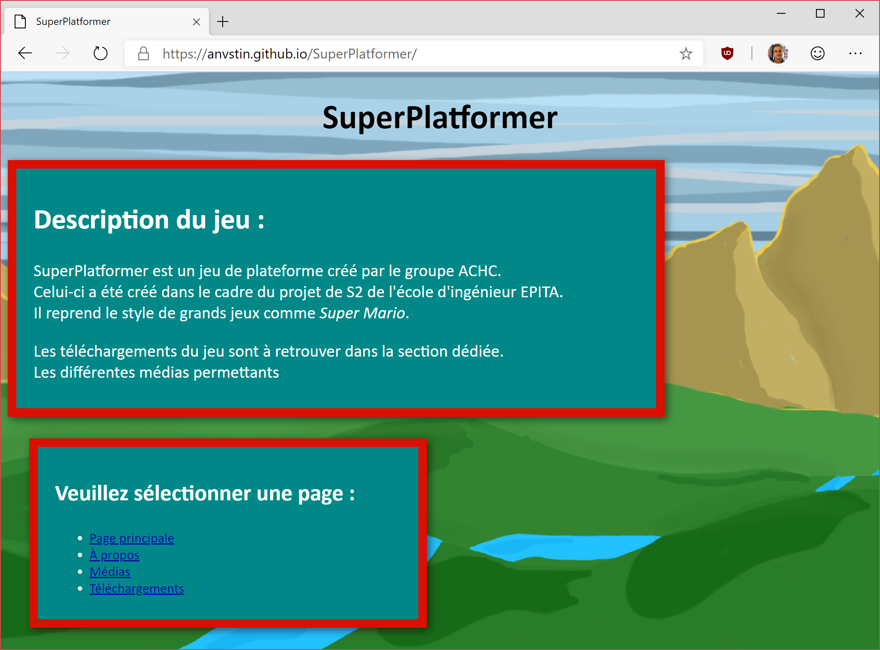
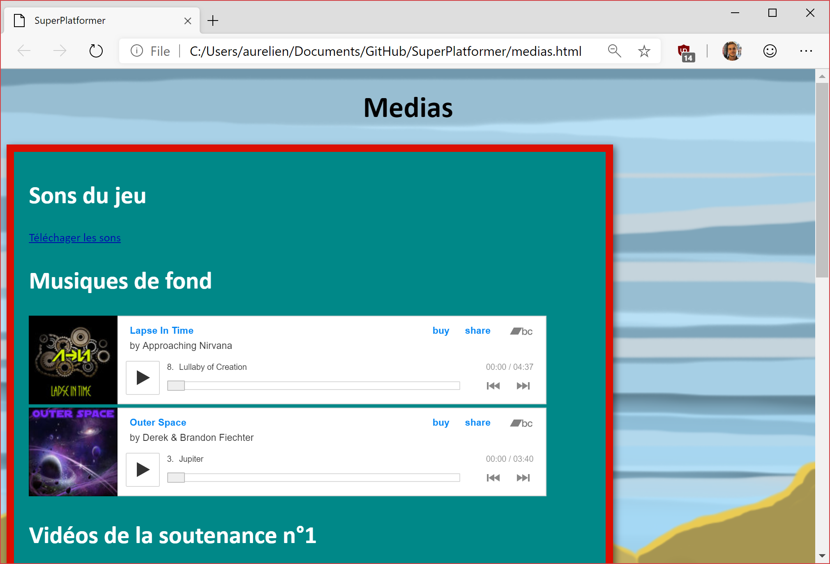
Game development: Sounds effects
Attack sound
Damage sound

Slide 17
Game development: Website
Time
Graphics
Sound

Slide 18
Encountered problems and solutions
Time
Graphics
Sound

Slide 19
Game demonstration

Slide 20
The outcome
Satisfied with the result of our product
Been able to finish our goals
Respect of the specifications

Slide 21
Conclusion

